Slide 1

ITA0506-COMPUTER VISION
Intelligent Traffic Sign Detection and Recognition using YOLOv8 and CNN with Driver Alert System
Guided by
Dr.R.C.Jeni Gracia
Presented by
G.D.S.P.Santosh Raja (192425064)
T.V.Sai Jagadeesh(192472146)
C.Chandu (192472332)
Y.Sravan Kumar (192472289)
B.Rakesh (192425241)
Y.Tejanvesh Reddy(192425156)

Slide 2


AGENDA
Introduction to traffic sign recognition system
Review of existing methods
Problem Statement
Objectives of the project
System Architecture
Module-wise explanation

Slide 3
INTRODUCTION
Traffic signs are essential for maintaining road safety and guiding drivers.
In real-world situations, drivers may miss signs due to fatigue, distractions, or poor visibility.
Missing important signs like speed limits or stop signs can lead to accidents.
To solve this problem, intelligent systems are developed using Artificial Intelligence.
This system uses YOLOv8 for detection and CNN for classification.
It can automatically detect traffic signs from live video and recognize their meaning.

Slide 4
LL LITERATURE REVIEW
Title | Authors & Year | Technologies Used | Research Gaps Identified
Traffic Sign Detection using Traditional Computer Vision Techniques | A. Sharma et al. (2021) | Image Processing, SVM, HOG | Low accuracy in complex environments and poor performance in real-time
Real-Time Traffic Sign Detection using Deep Learning | B. Lee et al. (2022) | CNN, OpenCV, Deep Learning | Limited speed optimization for real-time applications
Traffic Sign Recognition using YOLO-based Model | C. Wang et al. (2023) | YOLOv5, Object Detection | Difficulty in detecting small and multiple signs simultaneously
Traffic Sign Detection with Object Tracking Systems | D. Kumar et al. (2023) | YOLO, Deep SORT, Kalman Filter | Lack of efficient temporal analysis and tracking consistency
Advanced Traffic Sign Recognition using YOLOv8 and Deep Learning | F. John et al. (2025) | YOLOv8, CNN | Still lacks fully optimized real-time deployment and robustness in all weather conditions

Slide 5

PROBLEM STATEMENT
Drivers may miss traffic signs due to bad weather, low visibility, or lack of attention.
Existing systems are often slow and not suitable for real-time detection.
They struggle to detect multiple traffic signs at the same time.
Many systems do not track signs continuously across video frames. There is a need for a system that can detect, track, recognize signs, and alert the driver instantly.

Slide 6
OBJECTIVES
To develop a real-time traffic sign detection system .
To use YOLOv8 for fast and accurate object detection and classify traffic signs using CNN or transfer learning.
To track multiple objects across frames and extract relevant regions for better processing.
To provide real-time alerts to drivers To improve overall road safety.

Slide 7
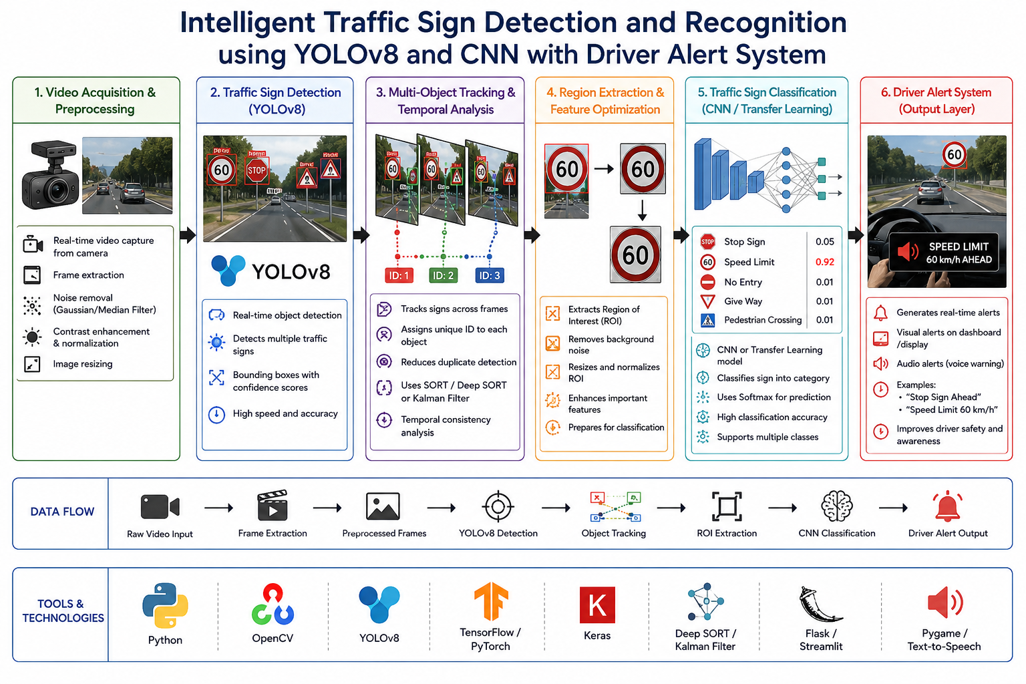
Architecture

Slide 8


MODULES
Module 1: Intelligent Video Acquisition & Adaptive Preprocessing
Captures real-time video using a camera.
Converts video into frames for processing.
Module 2:Real-Time Traffic Sign Detection using YOLOv8
YOLOv8 detects traffic signs in each frame.
It identifies objects and draws bounding boxes.
Module 3:Multi-Object Tracking & Analysis
Tracks detected traffic signs across frames.
Assigns a unique ID to each object.
Avoids repeated detection of the same sign.

Slide 9
MODULEs
Module 4:Region Extraction & Feature Optimization
Extracts only the detected region from the image.
Removes unnecessary background information.
Module 5:Traffic Sign Classification using CNN / Transfer Learning
CNN model classifies the detected traffic sign.
It identifies the type of sign such as:
Stop
Speed limit
Warning signs etc..
Module 6: Driver Alert & Decision Support System
Provides real-time alerts to the driver after detecting traffic signs
Converts detected signs into simple voice and visual messages
Helps drivers take quick and correct decisions while driving

Slide 10
THANK YOU

